Slide 1







Build end-to-end IoT solutions Messaging processing, analytics, and business integration
Pamela Cortez
Microsoft Azure IoT

Slide 2





Build end-to-end IoT solutions – Workshop Series
https://aka.ms/IoT-online-workshop
Transform your business with IoT
Devices and device communication
Device provisioning at scale
Messaging processing, analytics, and business integration
Work with Azure IoT Edge

Slide 3
Messaging processing, analytics, and business integration
Time Series Insights
Azure Stream Analytics
Message Routing
Event Grid Integration
Developer Resources & Getting started

Slide 4


Microsoft IoT
Broadest portfolio
Industry Solutions
Manufacturing
Retail
Agriculture
Energy
Smart Cities
Healthcare
Transportation
Azure IoT Central
Dynamics Connected Field Service
IoT app services
Azure IoT Hub
Azure IoT Hub Device Provisioning Service
Azure Digital Twins
Azure Time Series Insights
Azure Maps
Azure Security Center for IoT
Azure Stream Analytics
Azure Cosmos DB
Azure AI
Azure Cognitive Services
Azure ML
Azure Logic Apps
Azure Active Directory
Azure Monitor
Azure DevOps
Power BI
Azure Data Share
Azure Spatial Anchors
Azure services for IoT
Azure RTOS
Azure Sphere
Azure IoT Device SDK
Azure IoT Edge
Azure Stack Edge
Windows IoT
Azure Certified for IoT—Device Catalog
Azure Stream Analytics
Azure Storage
Azure ML
Azure SQL
Azure Functions
Azure Cognitive Services
IoT & Edge Device Support

Slide 5

High-level IoT Architecture
UI & reporting Tools
Configure and control
Visualize data and learnings
Cloud Gateway
Stream Processing
Business Integration
Stream processing and
rules evaluations over data
Provision and send data from devices to Cloud
IoT Devices
IoT Devices
IoT Devices
IoT Devices
Storage
Device Management
Store data
Integrate with Business process
Things
Insights
Actions

Slide 6
Messaging processing, analytics, and business integration
Time Series Insights
Azure Stream Analytics
Message Routing
Event Grid Integration
Developer Resources & Getting started

Slide 7








Pursuing new opportunities
Notes:
Let’s talk about IoT…. The concept is really enticing.
You connect your people, places, and things together building an ecosystem of interdependences that produce all of this data. It’s exhilarating for people like me that geek out over statistics.

Slide 8

4 Problems with IoT Data
Lacks structural consistency
Needs contextualization
Requires infinite storage
Limited connections

Slide 9

Problems with IoT Data
Lacks structural consistency
Data coming from sensors and assets do not have consistent structures making it extremely difficult to aggregate and compare.

Slide 10

Problems with IoT Data
Needs contextualization
To analyze sensor and asset data accurately, you need the context of where the data came from, the asset’s relationship to other sensors, and access to historical performance in one place.

Slide 11
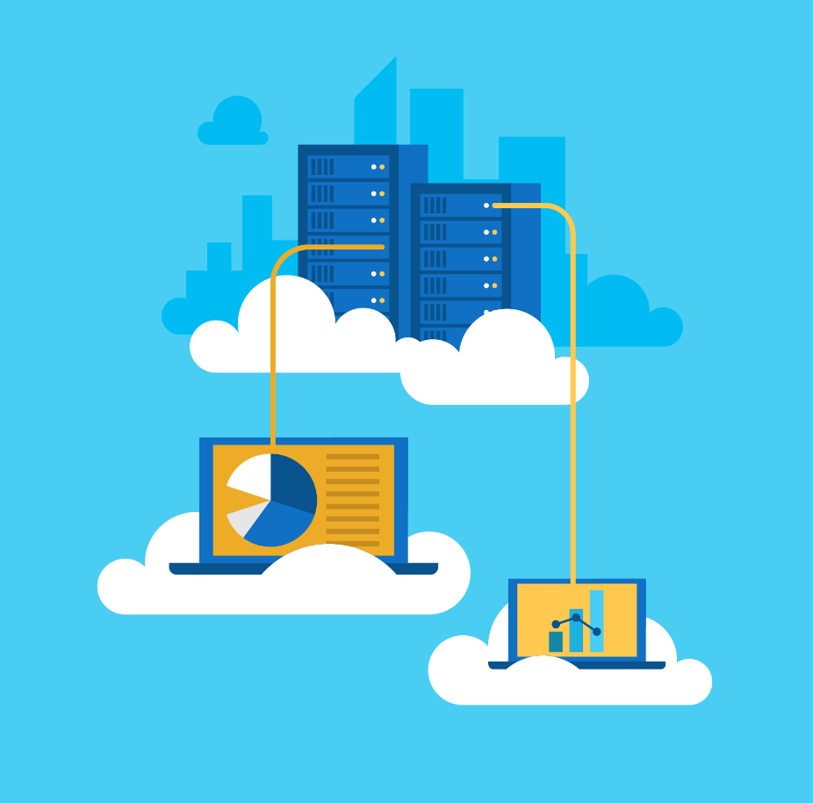
Problems with IoT Data
Requires infinite storage
Access to the billions of IoT events created over decades of capturing data needs to be easy and immediate.

Slide 12
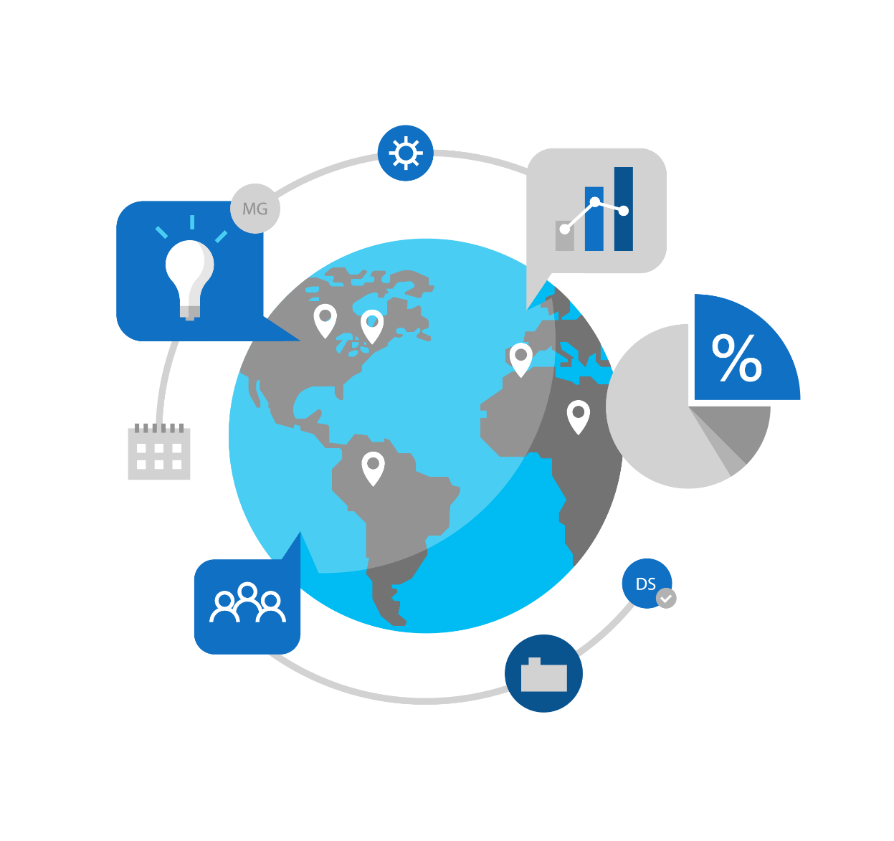
Problems with IoT Data
Limited connections
IoT data needs to be analyzed and consumed next to other business data to show the true business impact of IoT initiatives.

Slide 13




Purpose-Built
Contextual
ACCESSIBLE
Insightful

Slide 14



Azure Time Series Insights
A Serverless, Fully Managed Data Analytics Solution (PaaS) Built for IoT
Ingest, process, store, and query highly contextualized, time-series-optimized, IoT-scale data
Connect to a variety of data solutions using TSI’s flexible data platform
Use rich analytics APIs and UX for ad-hoc exploration and operational intelligence
Use JavaScript control library for building custom analytics apps on the TSI platform
Automated scaling and Pay-As-You-Go Pricing
Turn data into decisions with actionable real-time IoT insights

Slide 15


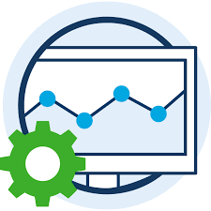

Built for IoT Turn inconsistent, unstructured data into useable information
Explore and monitor
Perform operational analysis
Models for learning & predictions
COLLECT
Collect time series data coming from different sources, formats & rates
PROCESS
Parse, Normalize, Enrich, Transform
STORE
Store in multi-layered time series data store optimized for a variety of analysis
ANALYZE
Run ad-hoc queries for monitoring; operationalize using asset-based analysis; use models for machine learning inference and make predictions

Slide 16






High Level Architecture
COLLECT
TSM API for metadata updates
Data Processing Engine
Time Series Model
PROCESS
Warm Storage
(30d data retention)
Cold Storage (infinite data retention)
STORE
Query API
ANALYZE
3rd party IoT App
TSI Explorer
Generally Available
In Public Preview

Slide 17
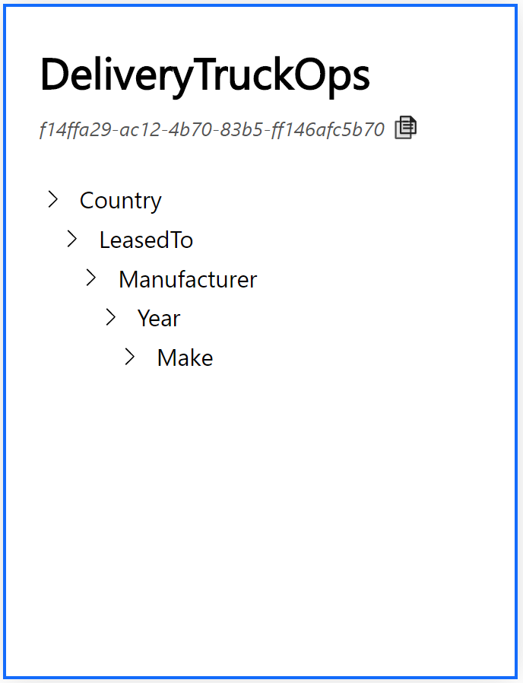
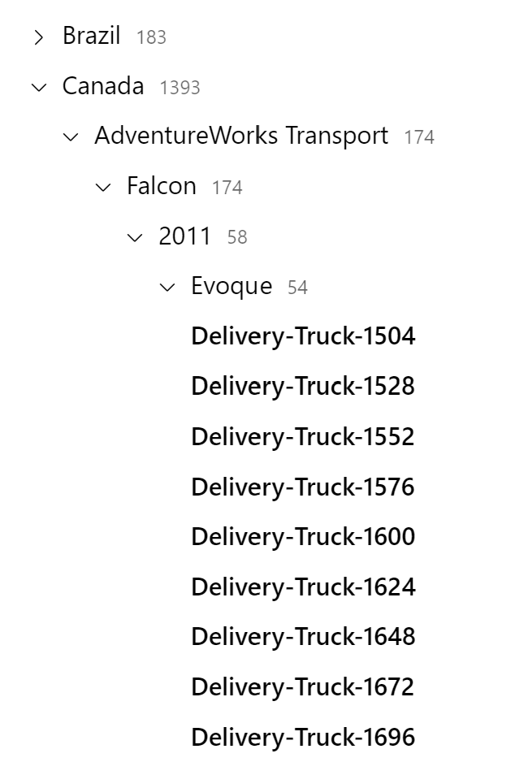
Contextualize data for better insights
Build custom contextual models based on relationships, hierarchies, asset types, variables, etc.
Upload current models to get started quickly.

Slide 18
Access your data when you need it
Multi layered storage with access to warm and cold analytics.
Integrate time series data into your own visualization tools with our open APIs.
Flexible storage platform allows custom storage containers based on your business needs.
Connect to and interop across a variety of advanced analytics scenarios such as predictive maintenance and machine learning using familiar technologies including Apache Spark™, Databricks, Jupyter, etc.
Warm Storage
(31d data retention)
Cold Storage (infinite data retention)

Slide 19

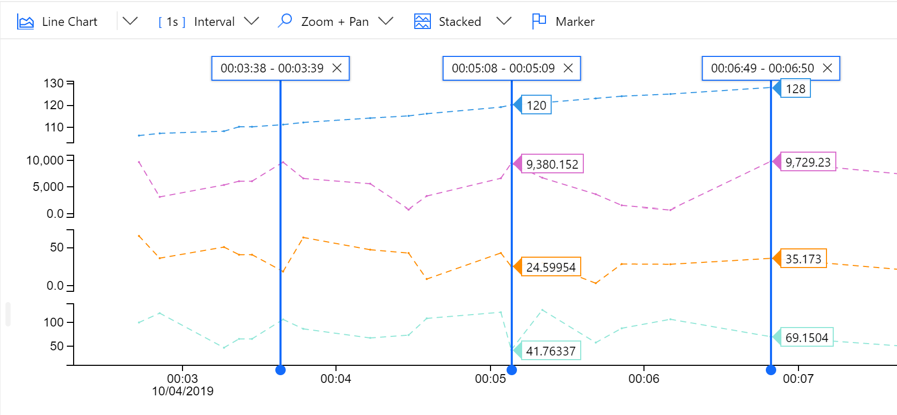
Insights to make business decisions
Visualize data for quick anomaly detection.
Run concurrent queries to scale IoT insights.
Reconstruct missing data for complete analysis.
Stay on connected to reality with near real-time data.
See data in context of business KPIs with PowerBI connector.

Slide 20


Put yourself in this situation:
You have a fleet of trucks delivering goods all over the world.
Unfortunately, your trucks in Canada are requiring more maintenance recently which hurts your profitability.
You’re tasked with figuring out why and proposing a solution.

Slide 21
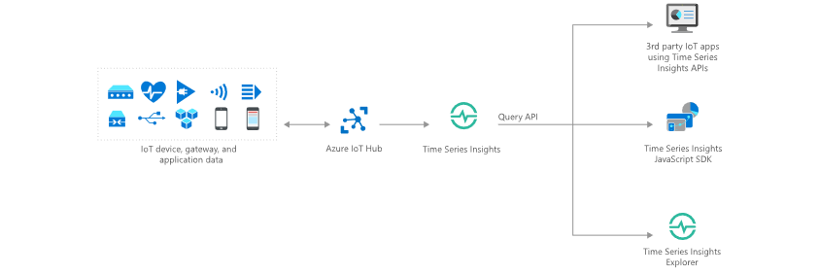
Data exploration and anomaly detection
Uncovering the Why
Anomaly detection and diagnosis
Examples:
Understanding why equipment requires extra maintenance.
Searching why inventory was damaged.
Researching why production declined on an assembly line.
Chasing down a defect in the supply chain process.

Slide 22
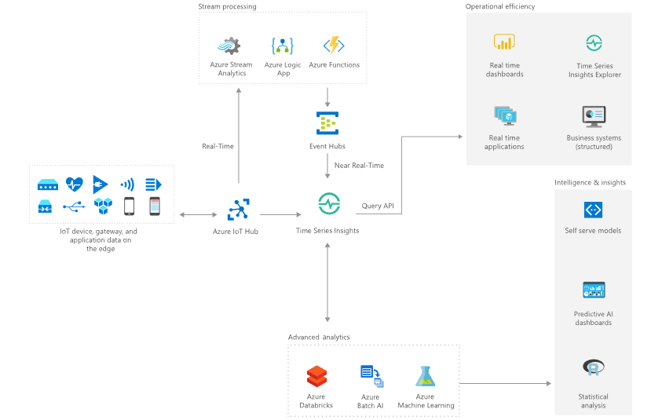
Improving operations Operational intelligence and advanced analytics
Examples:
Monitor equipment performance at scale
Identify process inefficiencies
Diagnose the health of equipment
Optimize supply chain and production

Slide 23
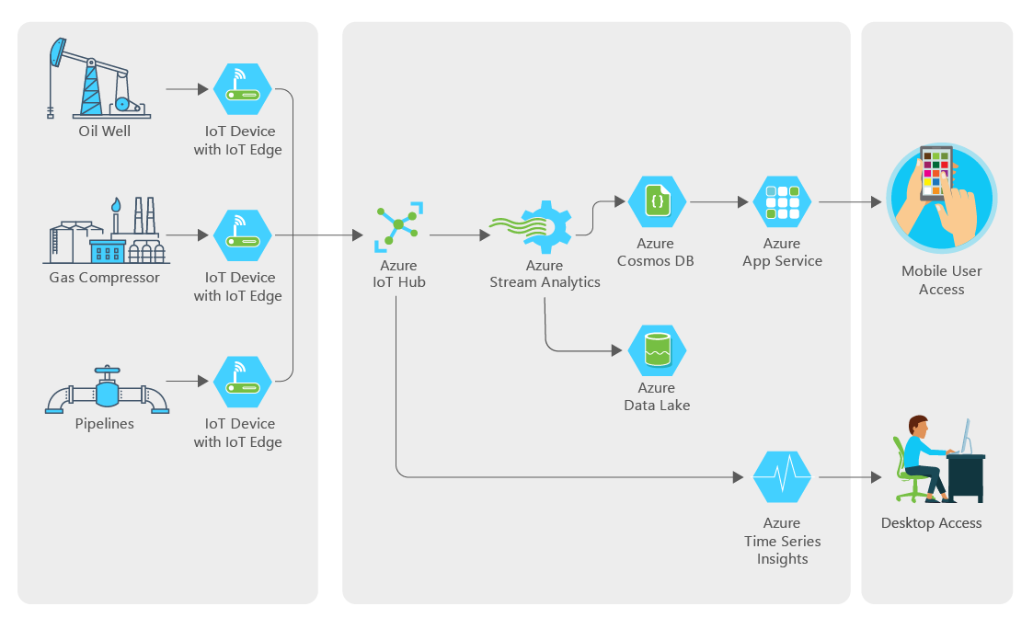

Slide 24
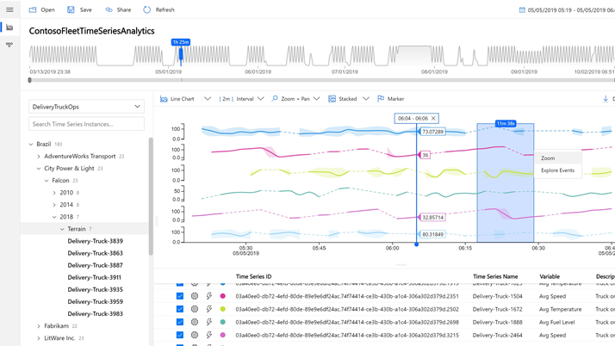
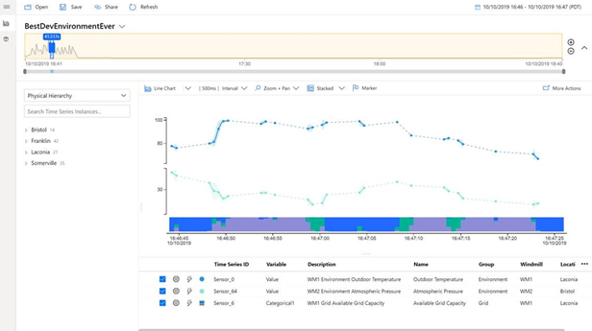

Azure Time Series Insights
Capabilities
Multi layered storage with warm and cold analytics support with the ability to route data to warm store for interactive analytics over short timespans and to cold store for operational intelligence over decades of historical data
Flexible data platform that supports taking data stored in open source Apache Parquet to other advanced data solutions such as Spark, Databricks, Jupyter for predictive maintenance, machine learning and AI
Bulk import support to bring decades of historical data in batch mode into TSI’s data lake store and get it ready for analytics
Rich query APIs and user experience to support interpolation, scalar and aggregate functions, categorical variables, scatter plots, and time shifting of time series signals for in-depth analysis.
Enterprise grade scale and performance at all layers of the solution to support’ industrial IoT needs
Rich extensibility through PowerBI connector to support time series query integration directly in PowerBI to provide a unified view of BI and time series analytics

Slide 25
Messaging processing, analytics, and business integration
Time Series Insights
Azure Stream Analytics
Message Routing
Event Grid Integration
Developer Resources & Getting started

Slide 26

High-level IoT Architecture
Cloud Gateway
Stream Processing
Stream processing and
rules evaluations over data
Provision and send data from devices to Cloud
IoT Devices
IoT Devices
IoT Devices
IoT Devices
Storage
Device Management
Store data
Things
Insights
Actions

Slide 27
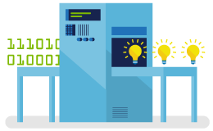
Unlocking Real-time Insights
Time to Insight is Critical
Reducing decision latency can unlock business value
Insights are Perishable
Window of opportunity for insights to be actionable
Ask Questions to Data in Motion
Can’t wait for data to get to rest before running computation

Slide 28
Why real-time analytics?
Insights are Perishable
Window of opportunity is limited
Time to Insight is Critical
Reducing decision latency can unlock business value
You can now query Data in Motion

Slide 29
Fully Managed PaaS offering for real-time analytics
Programmer productivity
Intelligent Edge, and Cloud
Serverless and low TCO
Easy to get started
Enterprise grade
Simple SQL language extensible with JavaScript and C#
Built-in Analytic functions
Azure Portal, VS Code, Visual Studio, PowerShell, REST APIs
Best in class debugging tools
Same queries running either on Edge, Cloud or Azure Stack
Leveraging IoT Edge for security and deployment
Fully managed Job service: no clusters to manage or VMs to provision
Pay as you go: pay by minute, start, stop on-demand
Scale-up and scale-out
Native, Zero code integration with 15+ Azure services
“<5 minutes to solution”
99.9% job level SLA
Highly certified and compliant
26 regions worldwide
Millisecond latencies

Slide 30








Real-time analytics with Stream Analytics
Ingest
Analyze
Deliver
Alerts and actions
IoT Devices
Event Hubs, Service Bus, Azure Functions etc.
Dynamic Dashboarding
Continuous / Streaming real-time analytics
IoT Hub
Logs, Files, Media
Power BI
Data Warehousing
Customer data, Financial Transactions
Azure Synapse Analytics
Kafka
Azure Stream Analytics
Storage / Archival
Event Hubs
Weather data
SQL DB, Azure Data Lake Gen1 and Gen 2,
Cosmos DB, Blob Storage etc.
Reference Data
Real-time scoring
(SQL DB, Blob store)
(Azure ML service)
Business Applications
Notes:
© Microsoft Corporation

Slide 31




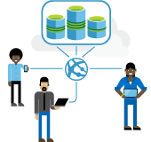
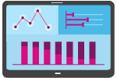

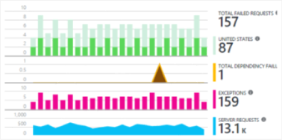
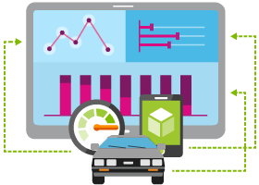

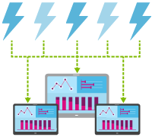

Scenario Examples
Real-time Fraud Detection | Streaming ETL | Predictive Maintenance | Call Center Analytics
IT Infrastructure and Network Monitoring | Customer Behavior Prediction | Log Analytics | Real-time Cross Sell Offers
Fleet monitoring and Connected Cars | Real-time Patient Monitoring | Smart Grid | Real-time Marketing
and many more…

Slide 32
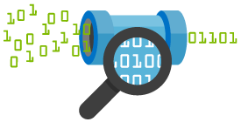
Real-time Stream Processing
Simple Event Processing
Filter
Transform
Enrich
Split
Route
Event Stream Processing
[Simple event processing] +
Aggregate
Rules
Complex Event Processing
[Event Stream Processing] +
Pattern detection
Time windows
Joins & correlations

Slide 33
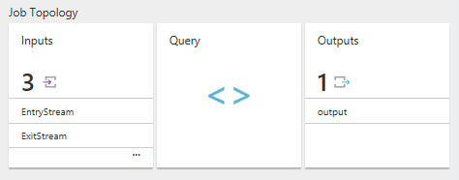
Stream Analytics Job
Users construct and deploy jobs to ASA
Job definition includes inputs, a query, and output
Inputs are from where the job reads the data stream
Query runs for perpetuity unless explicitly stopped and transforms the input stream
Output is where the job sends the job results to

Slide 34
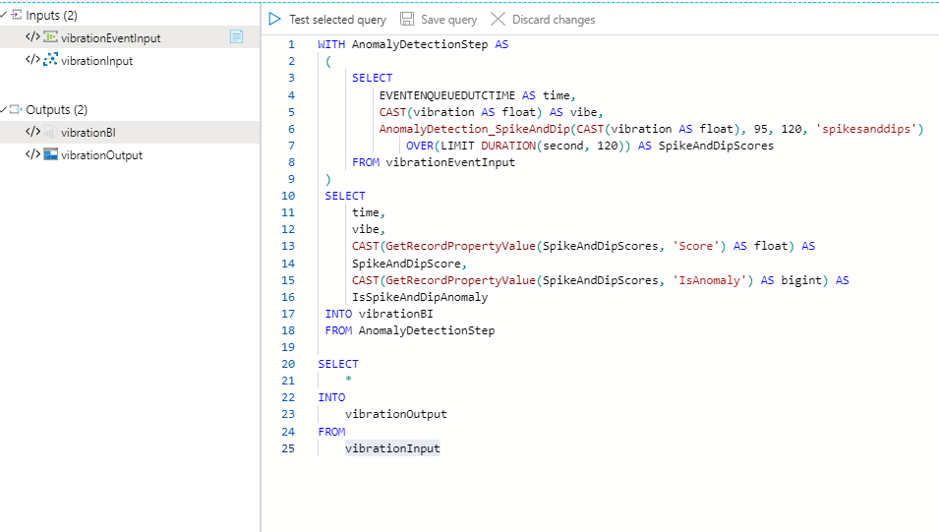

Slide 35
Stream Analytics Query Language (SAQL)
Declarative SQL like language to describe transformations
Filters (“Where”)
Projections (“Select”)
Time-window and property-based aggregates (“Group By”)
Time-shifted joins (specifying time bounds within which the joining events must occur)
and all combinations thereof
Data Manipulation SELECT FROM WHERE HAVING GROUP BY CASE WHEN THEN ELSE INNER/LEFT OUTER JOIN UNION CROSS/OUTER APPLY CAST INTO ORDER BY ASC, DSC
Date and Time
DateName
DatePart Day, Month, Year
DateDiff
DateTimeFromParts
DateAdd
String
Len
Concat
CharIndex
Substring
Lower, Upper
PatIndex
Temporal
Lag
IsFirst
Last
CollectTop
Mathematical
ABS
CEILING
EXP
FLOOR
POWER
SIGN
SQUARE
SQRT
Aggregation
SUM
COUNT
AVG
MIN
MAX
STDEV
STDEVP
VAR
VARP
TopOne
Windowing Extensions
TumblingWindow
HoppingWindow
SlidingWindow
Geospatial (preview)
CreatePoint
CreatePolygon
CreateLineString
ST_DISTANCE
ST_WITHIN
ST_OVERLAPS
ST_INTERSECTS
Scaling Extensions
WITH
PARTITION BY
OVER

Slide 36
Messaging processing, analytics, and business integration
Time Series Insights
Azure Stream Analytics
Message Routing
Event Grid Integration
Developer Resources & Getting started

Slide 37




IoT Hub Message Routing
Device
IoT Hub
Device to cloud message:
"message": {
"systemProperties": {
"contentType": "application/json",
"contentEncoding": "utf-8",
"iothub-message-source": "deviceMessages",
"iothub-enqueuedtime": "2017-05-08T18:55:31.8514657Z" },
"appProperties": {
"processingPath": "<optional>",
"verbose": "<optional>",
"severity": "<optional>",
"testDevice": "<optional>"
},
"body": "{\"Weather\":{\"Temperature\":50}}"
}
}
Device Twin:
{
"tags": {
"deploymentLocation": {
"building": "43",
"floor": "1"}
},
"properties": {
"desired": {
"telemetryConfig": {
"sendFrequency": "5m"},
"$metadata": {...},
"$version": 1
},
"reported": {
"telemetryConfig": {
"sendFrequency": "5m",
"status": "success"},
"batteryLevel": 55,
"$metadata": {… },
"$version": 4
}
}
}
D2C built-in endpoint
Event processing
(hot path)
routing queries
$twin.tags.building = 43
Custom endpoints connectors
Event processing
(hot and cold path)
Event Hub
severity = “high"
Service Bus Topics
$body.Weather.Temperature = 50 AND $twin.properties.desired.telemetryConfig.sendFrequency = '5m'
Service Bus Queues
Storage Blob
Data sources supported
Device Telemetry
Device Lifecycle Events
Device Twin Change Events
Learn more Message Routing

Slide 38
Messaging processing, analytics, and business integration
Time Series Insights
Azure Stream Analytics
Message Routing
Event Grid Integration
Developer Resources & Getting started

Slide 39
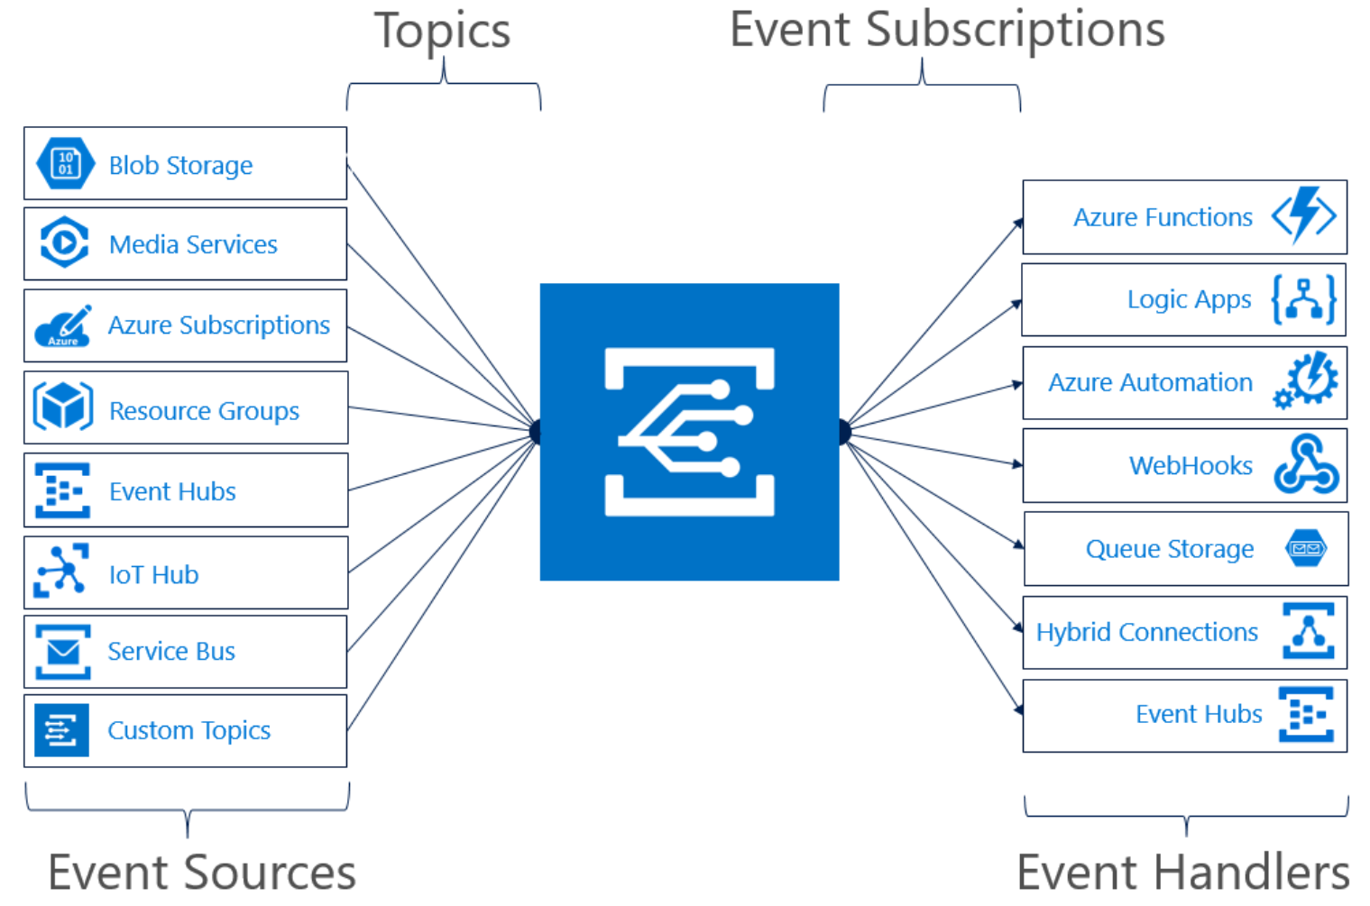
Serverless Integration
Events supported:
Device Telemetry
Device Created/Deleted Events
Device Connected/Disconnected Events
Learn more about Event Grid

Slide 40
Messaging processing, analytics, and business integration
Time Series Insights
Azure Stream Analytics
Message Routing
Event Grid Integration
Developer Resources & Getting started

Slide 41
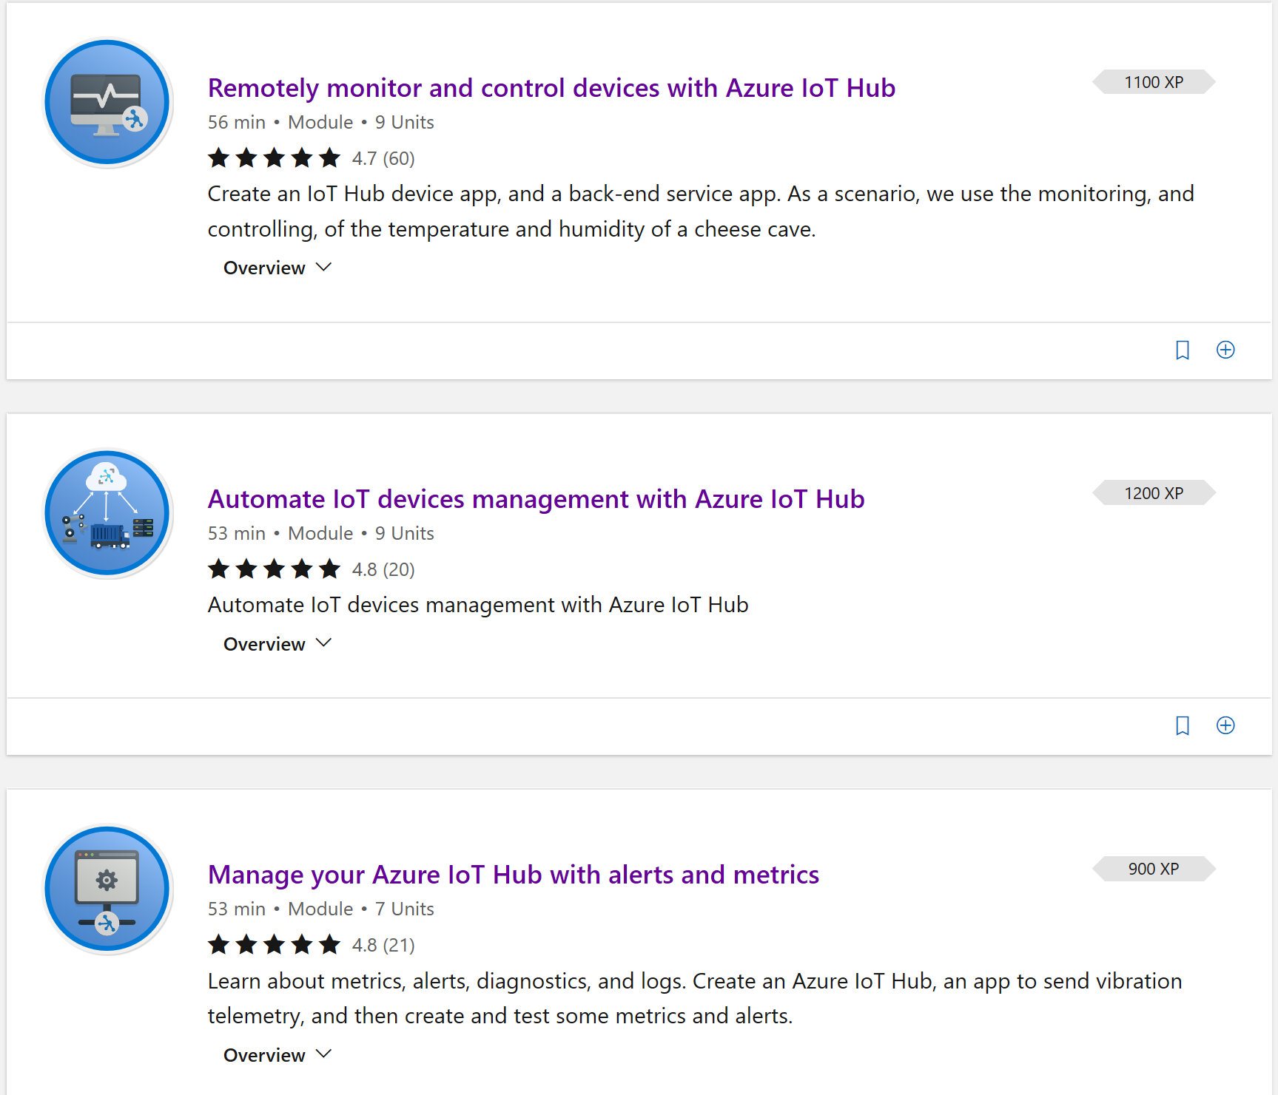

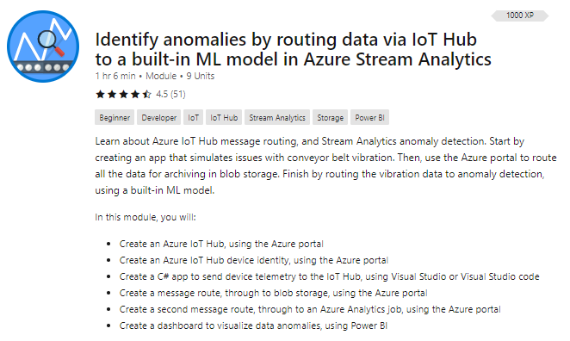

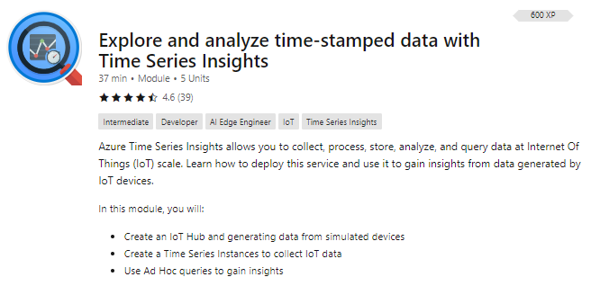
Get Started Now!
https://aka.ms/SecurelyConnectDevicesLearningPath
https://aka.ms/IntroAzureIoTLearningPath
Sign-up for Build end-to-end IoT solutions – Workshop Series
https://aka.ms/IoT-online-workshop
Transform your business with IoT
Devices and device communication – IoT Hub
Device provisioning at scale – Device Provisioning Service
Messaging processing, analytics, & business integration – Time Series Insights, Event Grid, Azure Stream Analytics
Work with Azure IoT Edge – IoT Edge

Slide 42
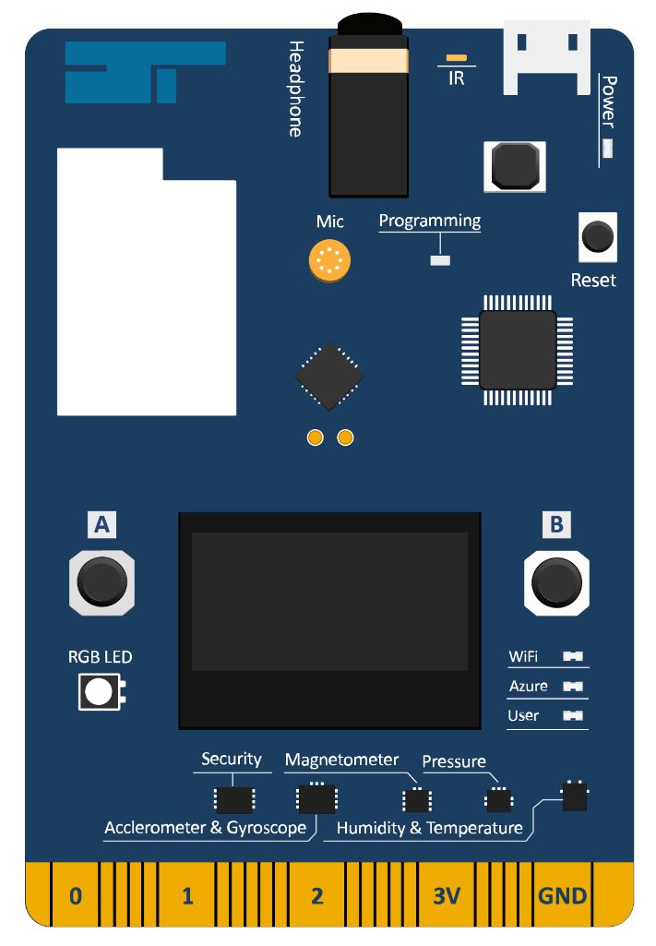
Hands-on End to End IoT Solution Tutorial
Azure IoT Workshop: Real-time asset tracking for international company Contoso Art Shipping
Tutorial:
https://azure.github.io/iot-workshop-asset-tracking/
IoT DevKit (MXChip):
https://microsoft.github.io/azure-iot-developer-kit/

Slide 43
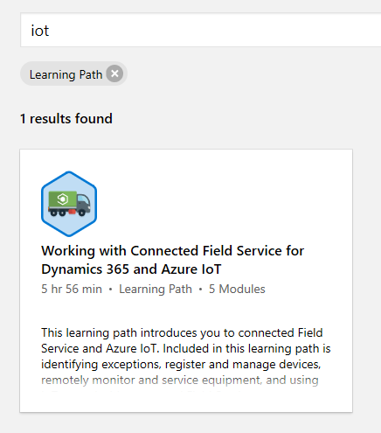
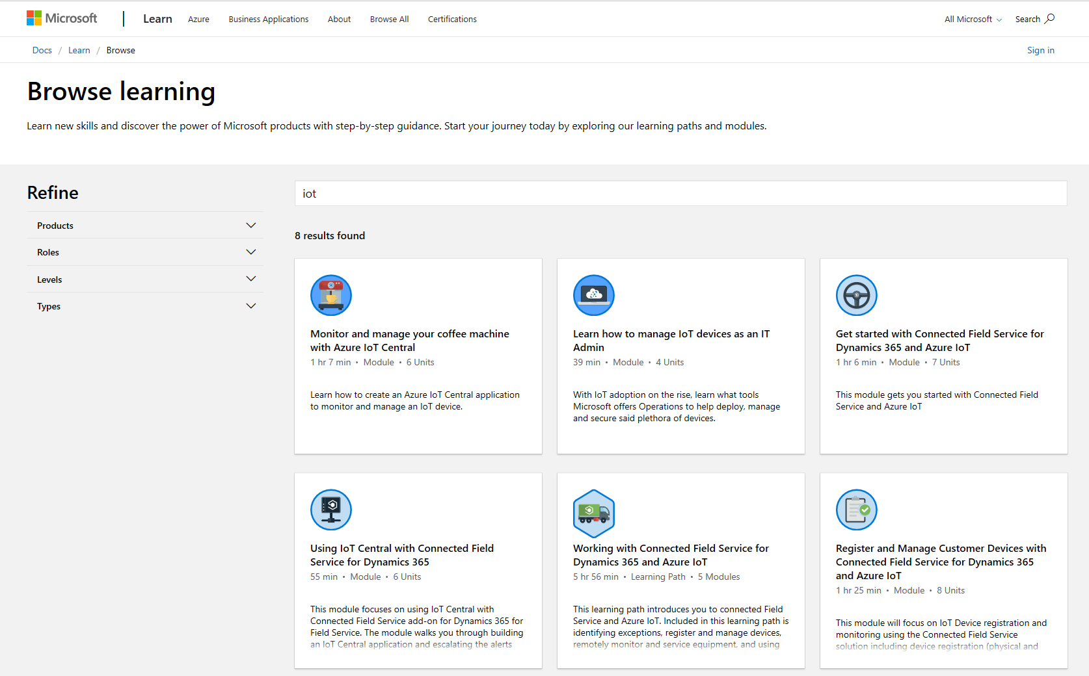
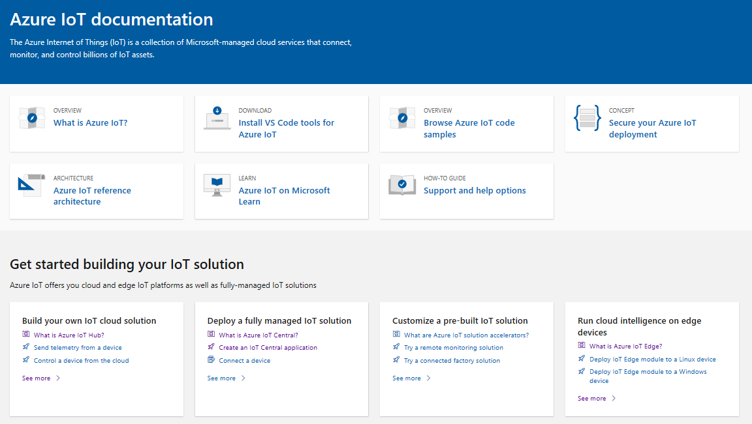
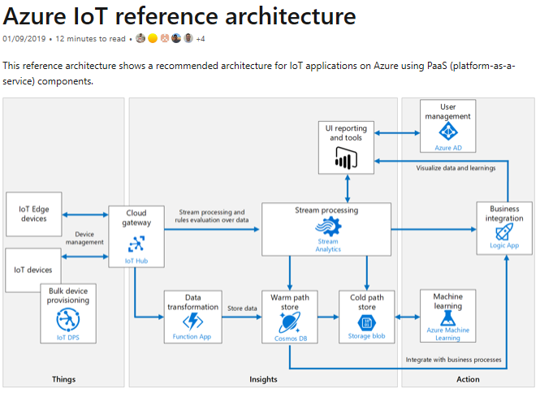
Learn how to get started with IoT
Building IoT solutions with Azure Developer Guide https://discover.microsoft.com/azure-iot-building-solutions-dev-guide/
Microsoft Learn learning paths
http://aka.ms/mslearniot
Microsoft Learn is a newer learning platform that offers sandbox online training
Azure IoT Reference Architecture Guide https://docs.microsoft.com/azure/architecture/reference-architectures/iot/
This reference architecture shows a recommended architecture for IoT applications on Azure using PaaS (platform-as-a-service) components.
Azure IoT Docs
Getting Started, Tutorials, How-to guides, reference, whitepapers

Slide 44
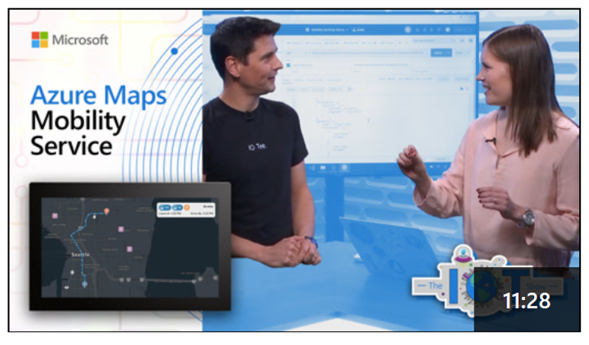
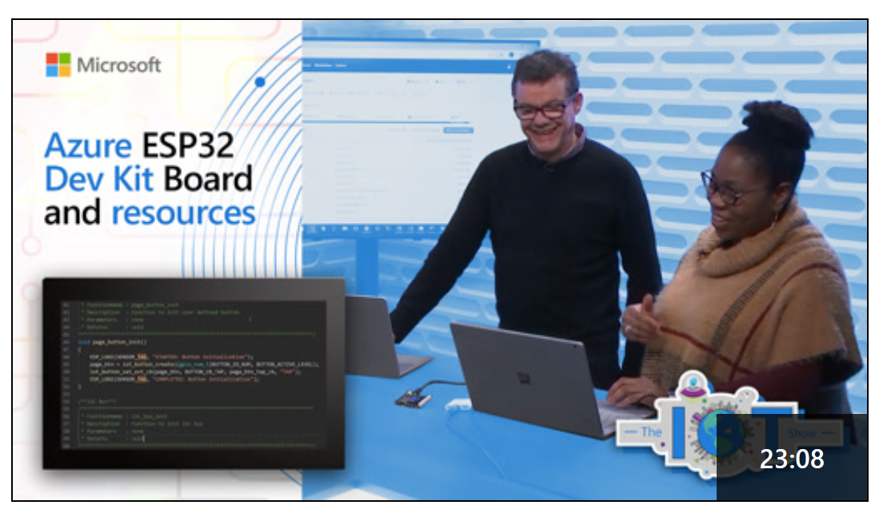
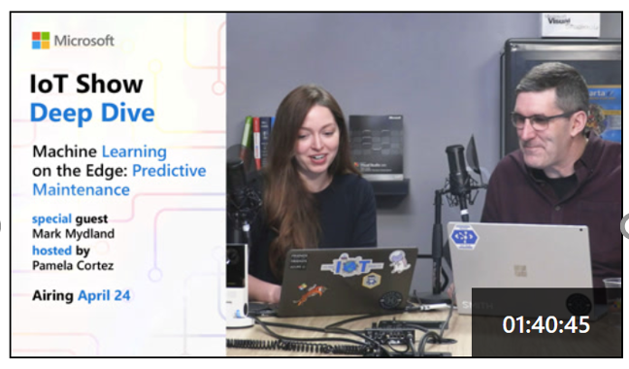
IoT Show
New video every Monday (Deep Dives on Wednesdays!) Subscribe to stay up-to-date with latest Microsoft IoT announcements, product and features demos, customer and partner spotlights, top industry talks, and technical deep dives with IoT Show! aka.ms/IoTShow

Slide 45
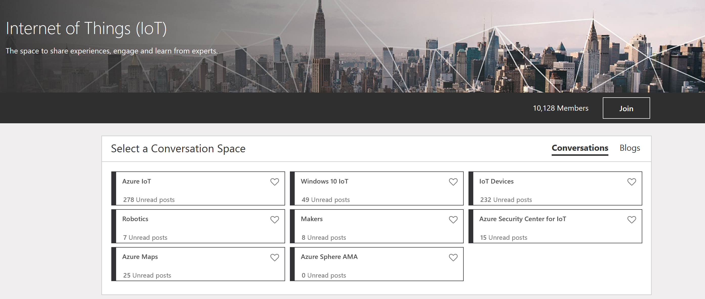
IoT Tech Community
Community forum to stay to update on latest announcements, connect with other developers, share your projects, and ask questions!
Fast growing vibrant community
One Microsoft IoT voice
http://aka.ms/iottechcommunity

